Slide 1

CMR TECHNICAL CAMPUS
Department of Computer Science and Engineering
2020-2024
MAJOR PROJECT REVIEW
BATCH NO:13
FRAUD DETECTION AND ANALYSIS FOR INSURANCE CLAIM USING MACHINE LEARNING
Presented by:
N.Sowmya 207R1A05A3
V.Chidrup 207R1A05B6
Ch.Kushal 207R1A0588
Under the guidance of :
Saba Sultana
(Assistant professor)

Slide 2
ABSTRACT
The main aim of this project is to build a User-friendly application to detect fraud insurances claim using ml algorithms.
It involves employing computer algorithms to automatically identify patterns or anomalies in insurance claims.
ML models are trained on historical data to learn typical claim patterns and detect unusual behaviors that may indicate fraudulent activities.
It reduces the risk of fraudulent payouts, and helps insurance companies save time and resources while ensuring fair compensation for legitimate claims.

Slide 3
CONTENTS
ABSTRACT
EXISTING SYSTEM
DISADVANTAGES OF EXISTING SYSTEM
PROPOSED SYSTEM
ADVANTAGES OF PROPOSED SYSTEM
REQUIREMENTS SPECIFICATION
NOVELTY
ARCHITECTURE
MODULES
UML DIAGRAMS
SAMPLE CODE
RESULTS
CONCLUSION
REFERENCES
FUTURE SCOPE
GITHUB LINK

Slide 4
EXISTING SYSTEM
In existing system most of the work is done manually.
The existing system for fraud detection and analysis in insurance claims often relies on:
Manual Checks
Rule-based Systems
Basic Data Analysis
Data Mining

Slide 5

DISADVANTAGES OF EXISTING SYSTEM
Time Consuming
No Security
Low accuracy
Can't understand complex data

Slide 6
PROPOSED SYSTEM
This project uses LR,XGB and SVM ml algorithms.
In proposed system everything is done online in which ml algorithms are used to detect whether the insurance claims are fake or not.
In this proposed system work can be done quickly which improves the accuracy and efficiency.
The proposed model is suitable for the real-time detection of many insurance claims.

Slide 7
ADVANTAGES OF PROPOSED SYSTEM
There are several advantages to the proposed system of Fraud Detection and Analysis for Insurance Claim using ml
Increased accuracy
Security
Efficiency
Adaptability

Slide 8
HARDWARE SOFTWARE REQUIREMENTS REQUIREMENTS
System : i3 or above
RAM : 8GB
Hard Disk : 516 GB SSD or above
Operating System : windows 8 or above
Coding Language : Python
Designing : Html , CSS , Javascript
Frameworks : Django
Database : MySQL(Wamp server)

Slide 9
MODULES
There are several modules that can be used to develop Fraud detection and analysis for Insurance claim using ml. Here are some key modules:
Data Ingestion
Feature engineering
Machine learning model training
Model Evolution

Slide 10
NOVELTY OF PROJECT
The novelty of the project lies in several aspects:
Diverse Algorithm Integration: By using multiple machine learning algorithms like LR, XGBoost, SVM, and Random Forest, the system gains a broader perspective, increasing its ability to detect various types of fraud.
Real-time Monitoring and Alerts: Real-time monitoring involves continuously analyzing incoming data (in this case, insurance claims) as they occur. The system is designed to detect suspicious patterns or anomalies in real-time. When such activity is identified, alerts are generated instantly to notify relevant stakeholders, such as fraud investigators or claims managers.
User-friendly Interface: A user-friendly interface is designed with simplicity and ease of use in mind, ensuring that users can interact with the system efficiently and intuitively.
This project provides a scalable, automated, and accurate solution to a growing problem that affects millions of users worldwide.
This project can help prevent financial losses.

Slide 11
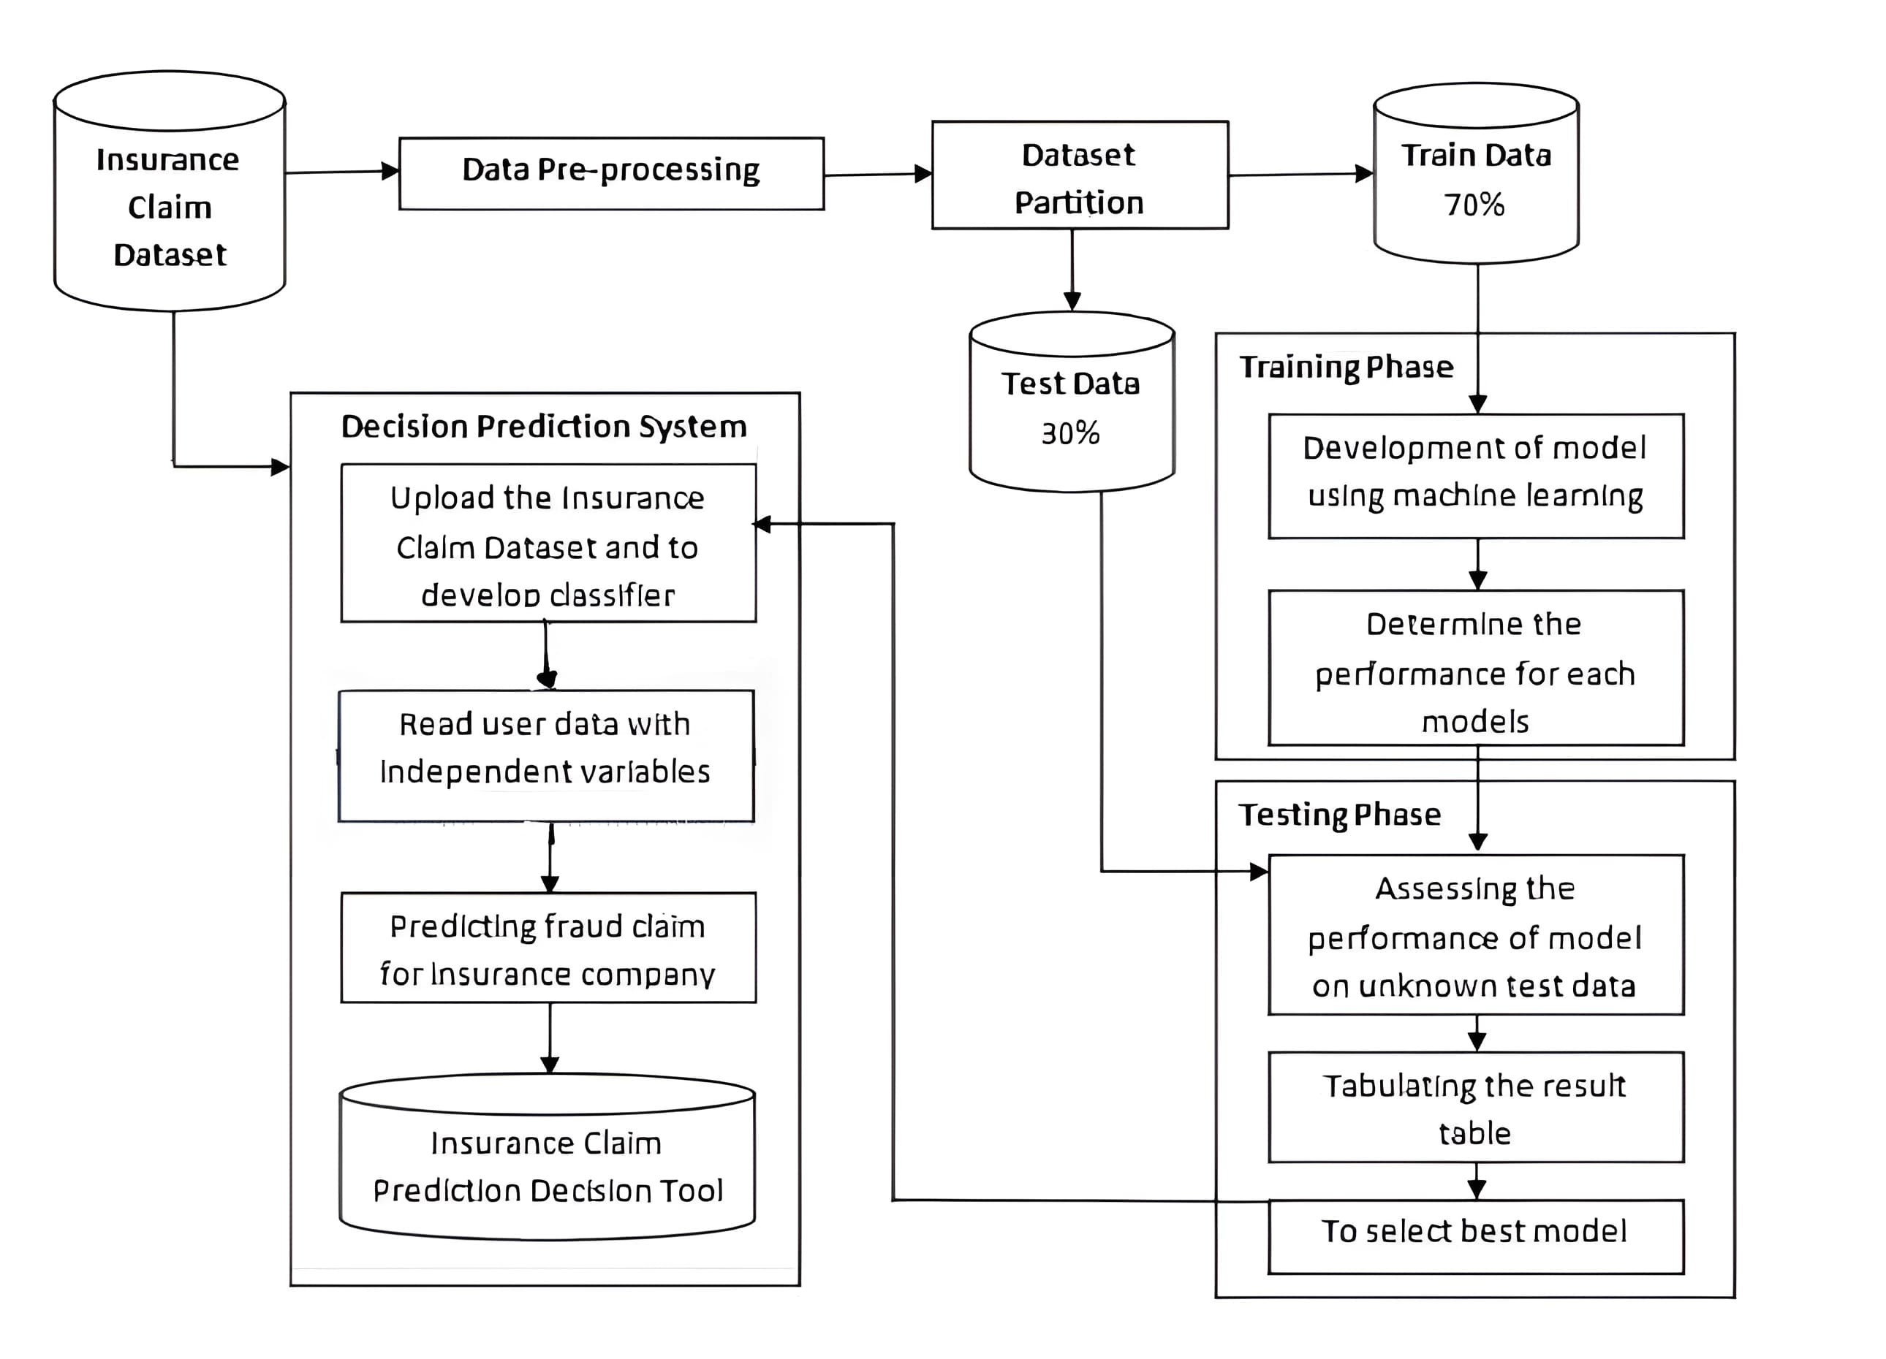
SYSTEM ARCHITECTURE

Slide 12
UML DIAGRAMS
Use case Diagram
a. System b. User

Slide 13
Class Diagram

Slide 14
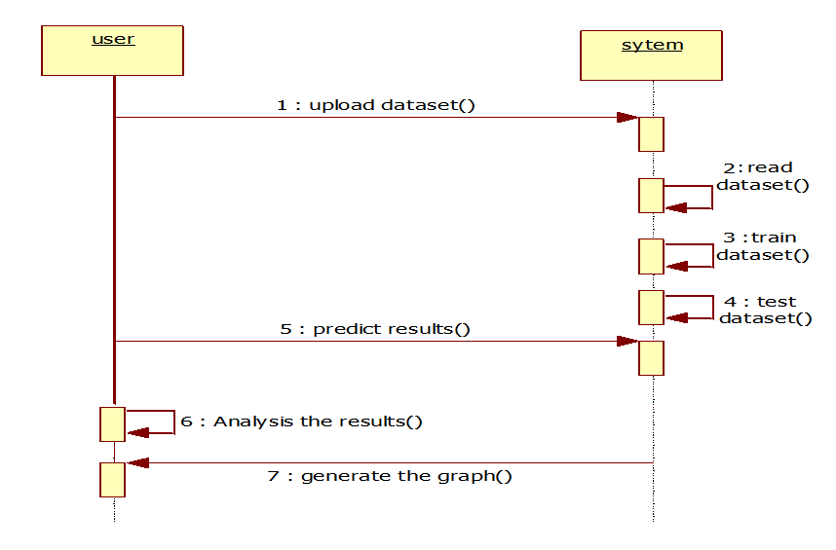
Sequence Diagram
X
X

Slide 15
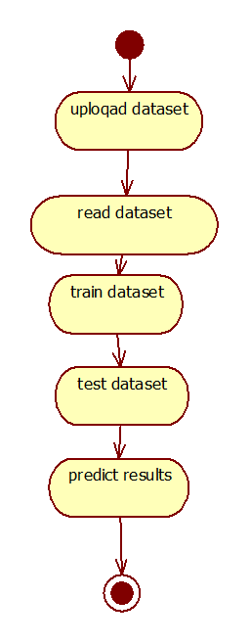
Activity Diagram

Slide 16
SAMPLE CODE
import pandas as pd
from matplotlib import pyplot as plt
import seaborn as sns
from sklearn.ensemble import ExtraTreesRegressor
from sklearn.preprocessing import LabelEncoder, StandardScaler
from sklearn.model_selection import train_test_split
import numpy as np
import sklearn.metrics
from pylab import rcParams
%matplotlib inline
pd.set_option('display.max_columns', 500)
pd.set_option('display.max_rows', 500)

Slide 17
fig = plt.figure(figsize=(10,6))
ax = (df['authorities_contacted'].value_counts()*100.0 /len(df))\
.plot.pie(autopct='%.1f%%', labels = ['Police', 'Fire', 'Other', 'None', 'Ambulance'], fontsize=12)
plt.style.use('fivethirtyeight')
fig = plt.figure(figsize=(10,6))
ax=df.groupby('collision_type').police_report_available.count().plot.bar(ylim=0)
ax.set_ylabel('Police report')
ax.set_xticklabels(ax.get_xticklabels(), rotation=10, ha="right")
plt.show()

Slide 18
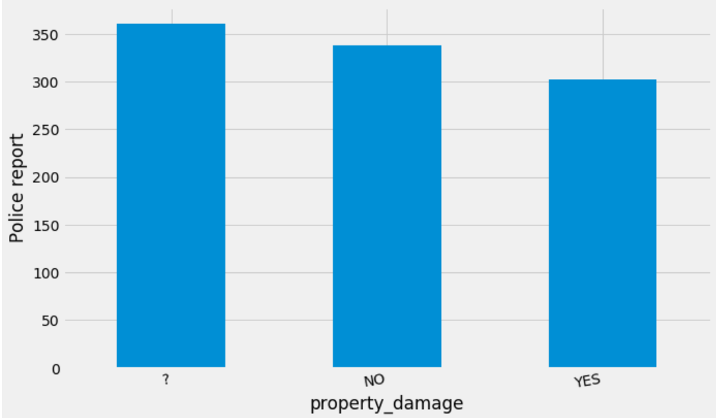
RESULTS

Slide 19
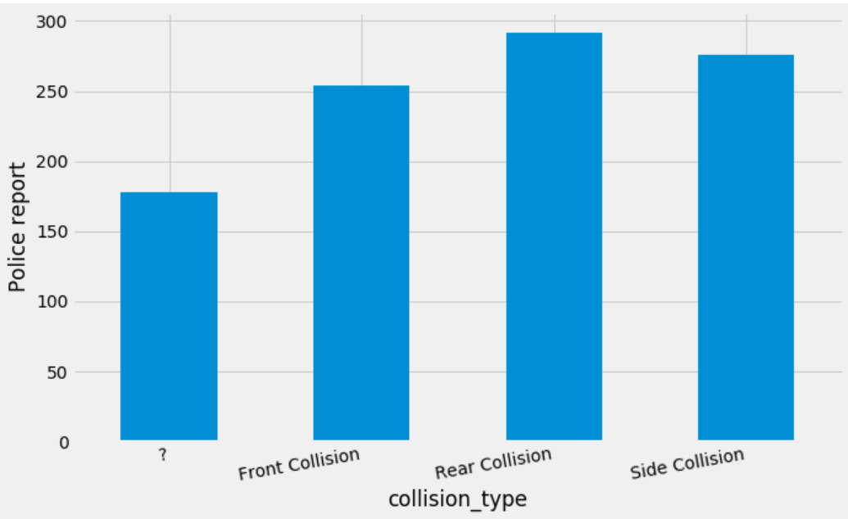

Slide 20
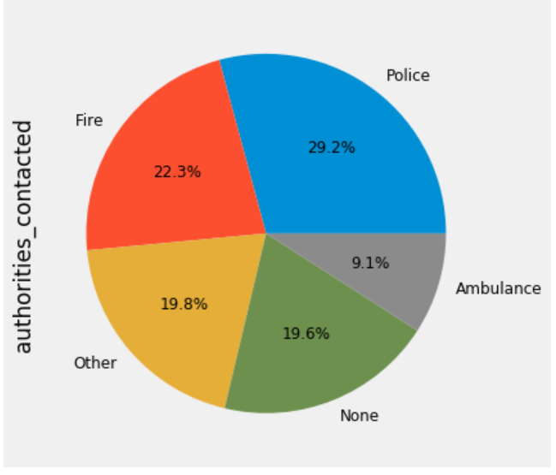

Slide 21
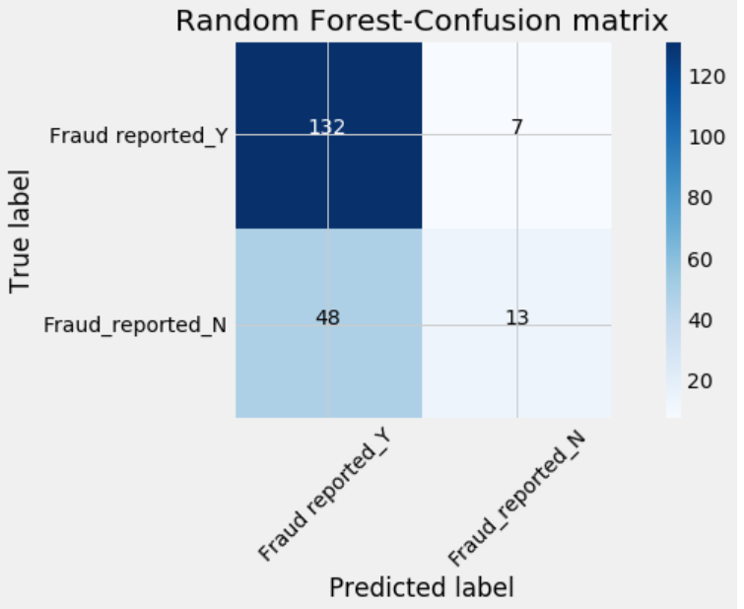

Slide 22
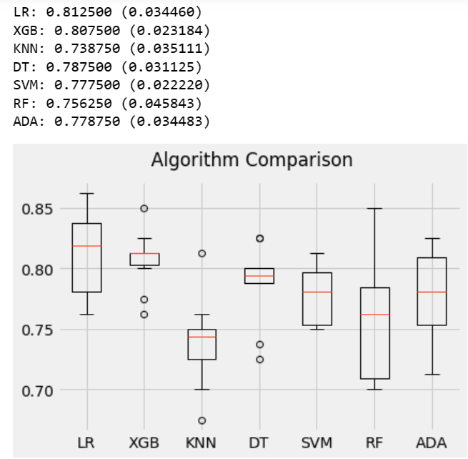

Slide 23
CONCLUSION
This project helps insurance companies stop fraud. It's like having a smart tool that quickly finds suspicious activities in insurance claims, making it easier for companies to protect themselves from losing money. The system is easy to use, so anyone can understand and use it well. It's a simple but powerful way to keep insurance operations safe and secure.
In summary, the project for fraud detection and analysis in insurance claims using machine learning offers an effective solution to identify and prevent fraudulent activities. By combining various machine learning algorithms like XGBoost, SVM, and Random Forest, the system can accurately detect fraud while minimizing false alarms.

Slide 24
REFERENCES
[1] K. Ulaga Priya and S. Pushpa, “A Survey on Fraud Analytics Using Predictive Model in Insurance Claims,” Int. J. Pure Appl. Math., vol. 114, no. 7, pp. 755–767, 2017.
[2] E. B. Belhadji, G. Dionne, and F. Tarkhani, “A Model for the Detection of Insurance Fraud,” Geneva Pap. Risk Insur. Issues Pract., vol. 25, no. 4, pp. 517– 538, 2000, doi: 10.1111/1468-0440.00080.
[3] F. C. Li, P. K. Wang, and G. E. Wang, “Comparison of the primitive classifiers with extreme learning machine in credit scoring,” IEEM 2009 - IEEE Int. Conf. Ind. Eng. Eng. Manag., vol. 2, no. 4, pp. 685– 688, 2009, doi: 10.1109/IEEM.2009.5373241.

Slide 25
FUTURE SCOPE
Real-time monitoring: Continuously watch incoming claims data and instantly flag any suspicious activities as they occur, allowing for immediate action to be taken to prevent fraud.
Automation: Use technology to automate repetitive tasks in claims processing, like document verification, to streamline processes, reduce errors, and speed up response times.
Continuous improvement: Regularly analyze past fraud cases and feedback from investigators to update and refine fraud detection systems, ensuring they stay effective against evolving fraud tactics.

Slide 26
GITHUB LINK
https://github.com/sowmya63/FRAUD-DETECTION-AND-ANALYSIS-FOR-INSURANCE-CLAIM-USING-MACHINE-LEARNING

Slide 27
THANK YOU

